Slide 1


AI-Powered Resume Screening & Job Recommendation
An automated Natural Language Processing and Supervised Machine Learning pipeline for scalable, intelligent, and unbiased recruitment classification.
Domain HR & Recruitment Automation
Technologies Python | NLP | TF-IDF | Streamlit
Core Classifier Logistic Regression / Naive Bayes
ML_Nerds

Slide 2

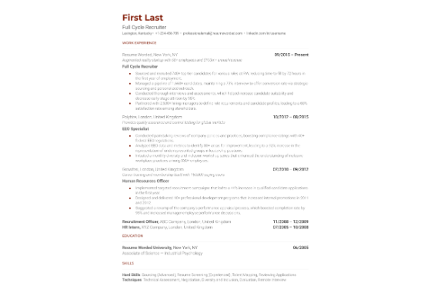
Problem Statement
High Application Volume: HR teams manually evaluate thousands of unstructured resumes per role.
Time-Consuming Process: Traditional manual inspection takes 6-10 seconds per CV, introducing hiring bottlenecks.
Inconsistency & Bias: Fatigue and individual subjectivity lead to inconsistent candidate evaluation.
Overlooked Talent: Highly qualified applicants are often missed due to manual filtering limitations.

Slide 3


Project Objectives
Core NLP & ML Pipeline
Deployment & Analytics
Develop a robust text preprocessing cleaner to normalize raw resume documents, remove stop words, and eliminate noise. Convert text into numeric vectors using TF-IDF feature extraction.
Train and evaluate supervised classifiers (Logistic Regression / Naive Bayes) using Accuracy, Precision, Recall, and F1-Score. Build an interactive Streamlit application for instant screening.

Slide 4
Existing vs Proposed System
Evaluation Dimension | Traditional Existing System | AI-Powered Proposed System
Screening Speed | Minutes/Hours per batch | Instant (< 1 second per resume)
Scalability | Low (Requires larger HR teams) | High (Handles thousands concurrently)
Evaluation Criteria | Subjective & variable per recruiter | Standardized algorithmic TF-IDF weights
Human Effort | Heavy manual reading & sorting | Automated sorting; decision support tool
Deployment Interface | Paper CVs & Static spreadsheets | Interactive Streamlit Web Dashboard

Slide 5






Literature Review & Gap
Keyword Matching
Complex Deep Learning
Our Light ML Hybrid
Early systems relied on rigid string matches, missing contextual skill synonyms and failing with diverse resume layouts.
BERT/Transformer models offer high accuracy but require excessive computational resources and lack real-time deployment simplicity.
Combines TF-IDF n-grams with Logistic Regression for optimal accuracy, ultra-fast latency, and lightweight Streamlit web hosting.

Slide 6
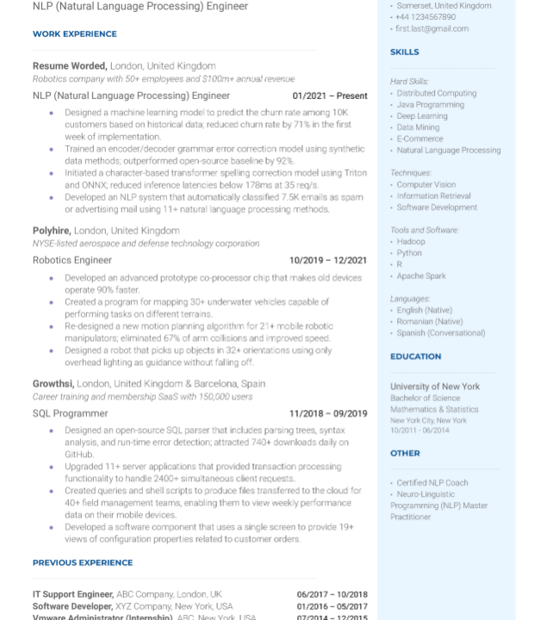
Proposed System Solution
End-to-End Automated Screening
Our solution bridges the gap between unstructured text input and structured candidate categorization. By combining regex text cleaning with TF-IDF vectorization, raw resume text is transformed into meaningful statistical feature vectors.
A trained multi-class Logistic Regression model analyzes the term frequencies to accurately predict job roles across 25+ categories in real-time, displaying confidence scores to recruiters.

Slide 7
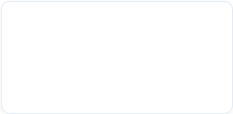
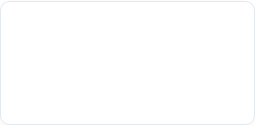
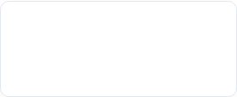
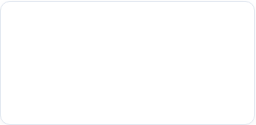
System Architecture Pipeline
2. NLP Cleaning
4. Classification
Regex cleaning, URL removal, punctuation stripping & lowercasing.
Logistic Regression model predicts job role category & recommendation.
1. Data Input
3. TF-IDF Encoding
Raw resume text paste or PDF document upload via Streamlit UI.
Term frequency-inverse document frequency sublinear feature scaling.

Slide 8
Kaggle Dataset Overview
Structured Resume Dataset
25+
Curated from Kaggle's Updated Resume Dataset containing 962 multi-domain records.
Encompasses diverse industry domains including Data Science, Java Developer, DevOps, HR, Healthcare, Finance, Arts, and Engineering.
Predefined Job Categories
Ensures balanced representation across varied technical terminologies and organizational role expectations.

Slide 9



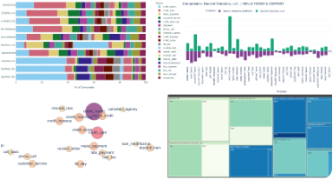

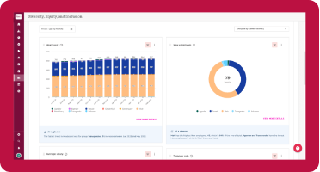
Application Workflow & Demo
1. Document Ingestion
2. Feature Extraction
3. Instant Prediction
User uploads PDF/Docx or pastes raw resume content directly into web UI.
Automated regex cleaning strips URLs and special symbols before TF-IDF transform.
Model displays top matching category and candidate suitability recommendation.

Slide 10
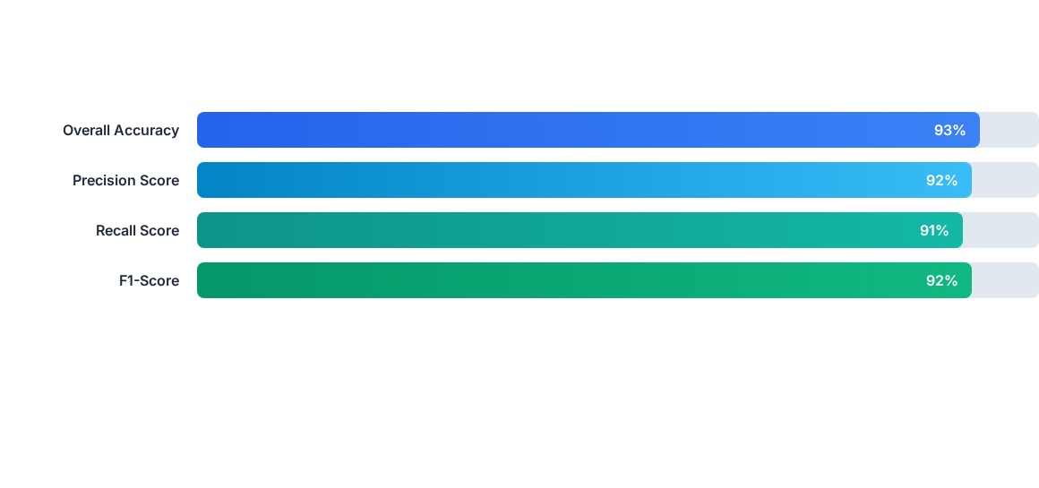
Model Performance Metrics
Evaluated on test set split using Scikit-Learn metrics. Logistic Regression combined with TF-IDF achieved balanced classification across all 25+ job categories.

Slide 11
Future Scope & Conclusion
Integrating Transformer embeddings (BERT), automated skill-gap analysis, ATS compatibility scoring, and multi-language support in upcoming releases.
Thank you! Questions & Discussions
ML Bubble 2026 Challenge | Domain: HR & Recruitment Automation

